Slide 1
Client-Server communication in C#

Slide 2
Agenda
The end goal
Client <-> Server socket communication

Slide 3
Where we want to end up

Slide 4
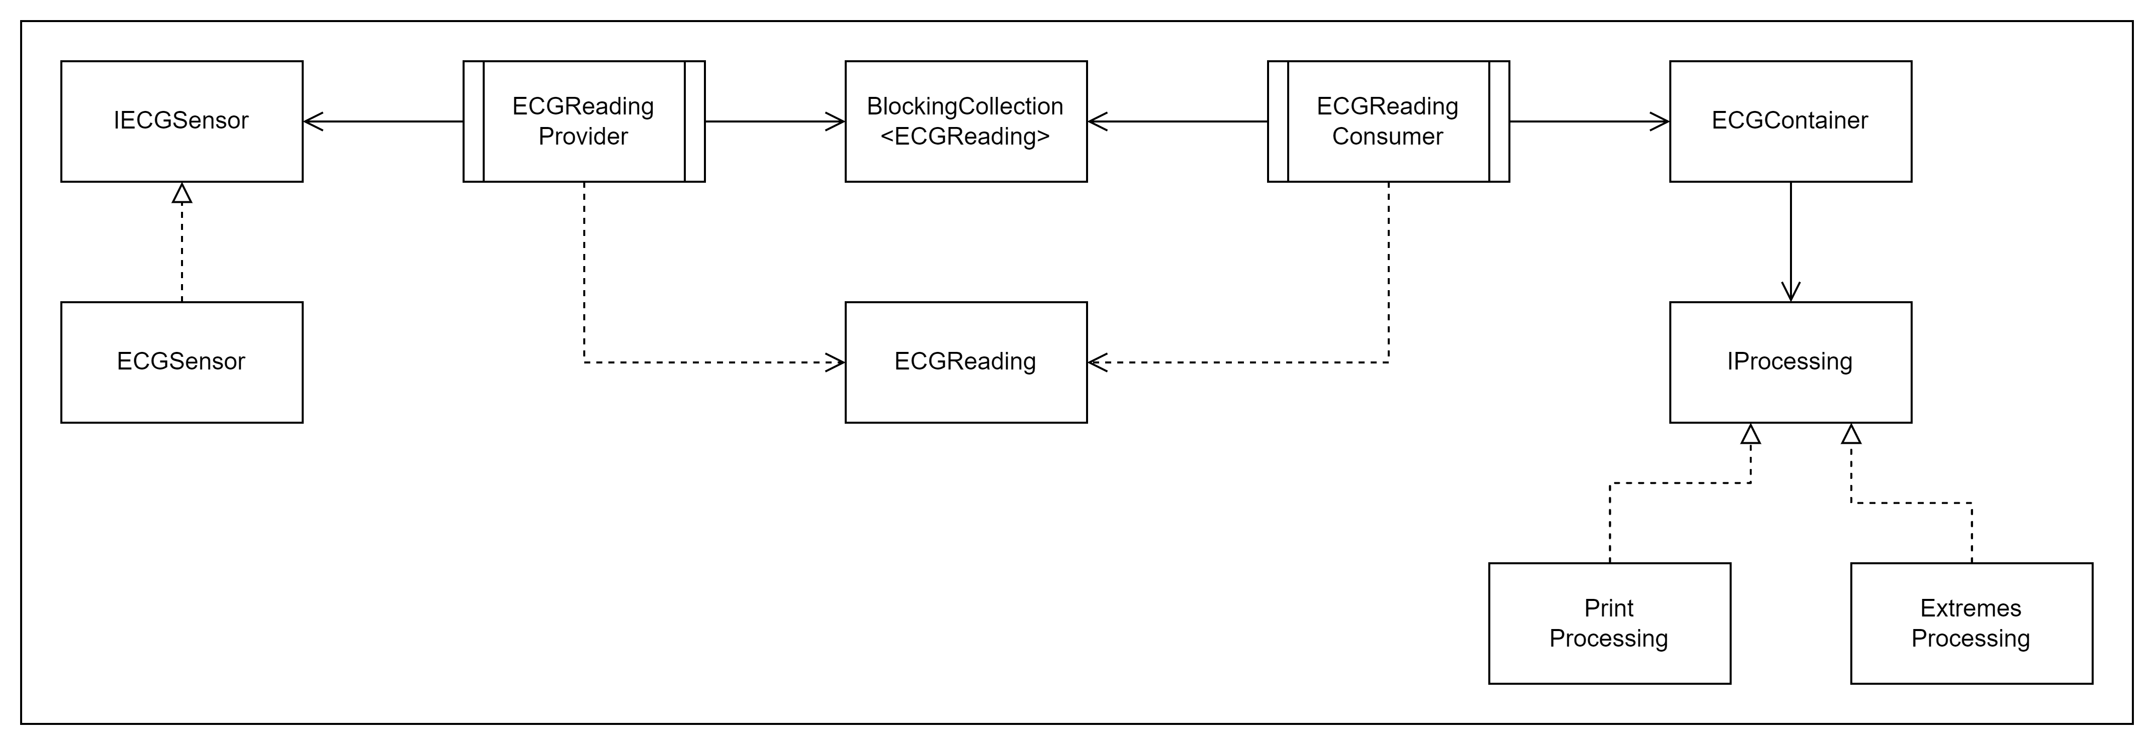
We want to go from this

Slide 5
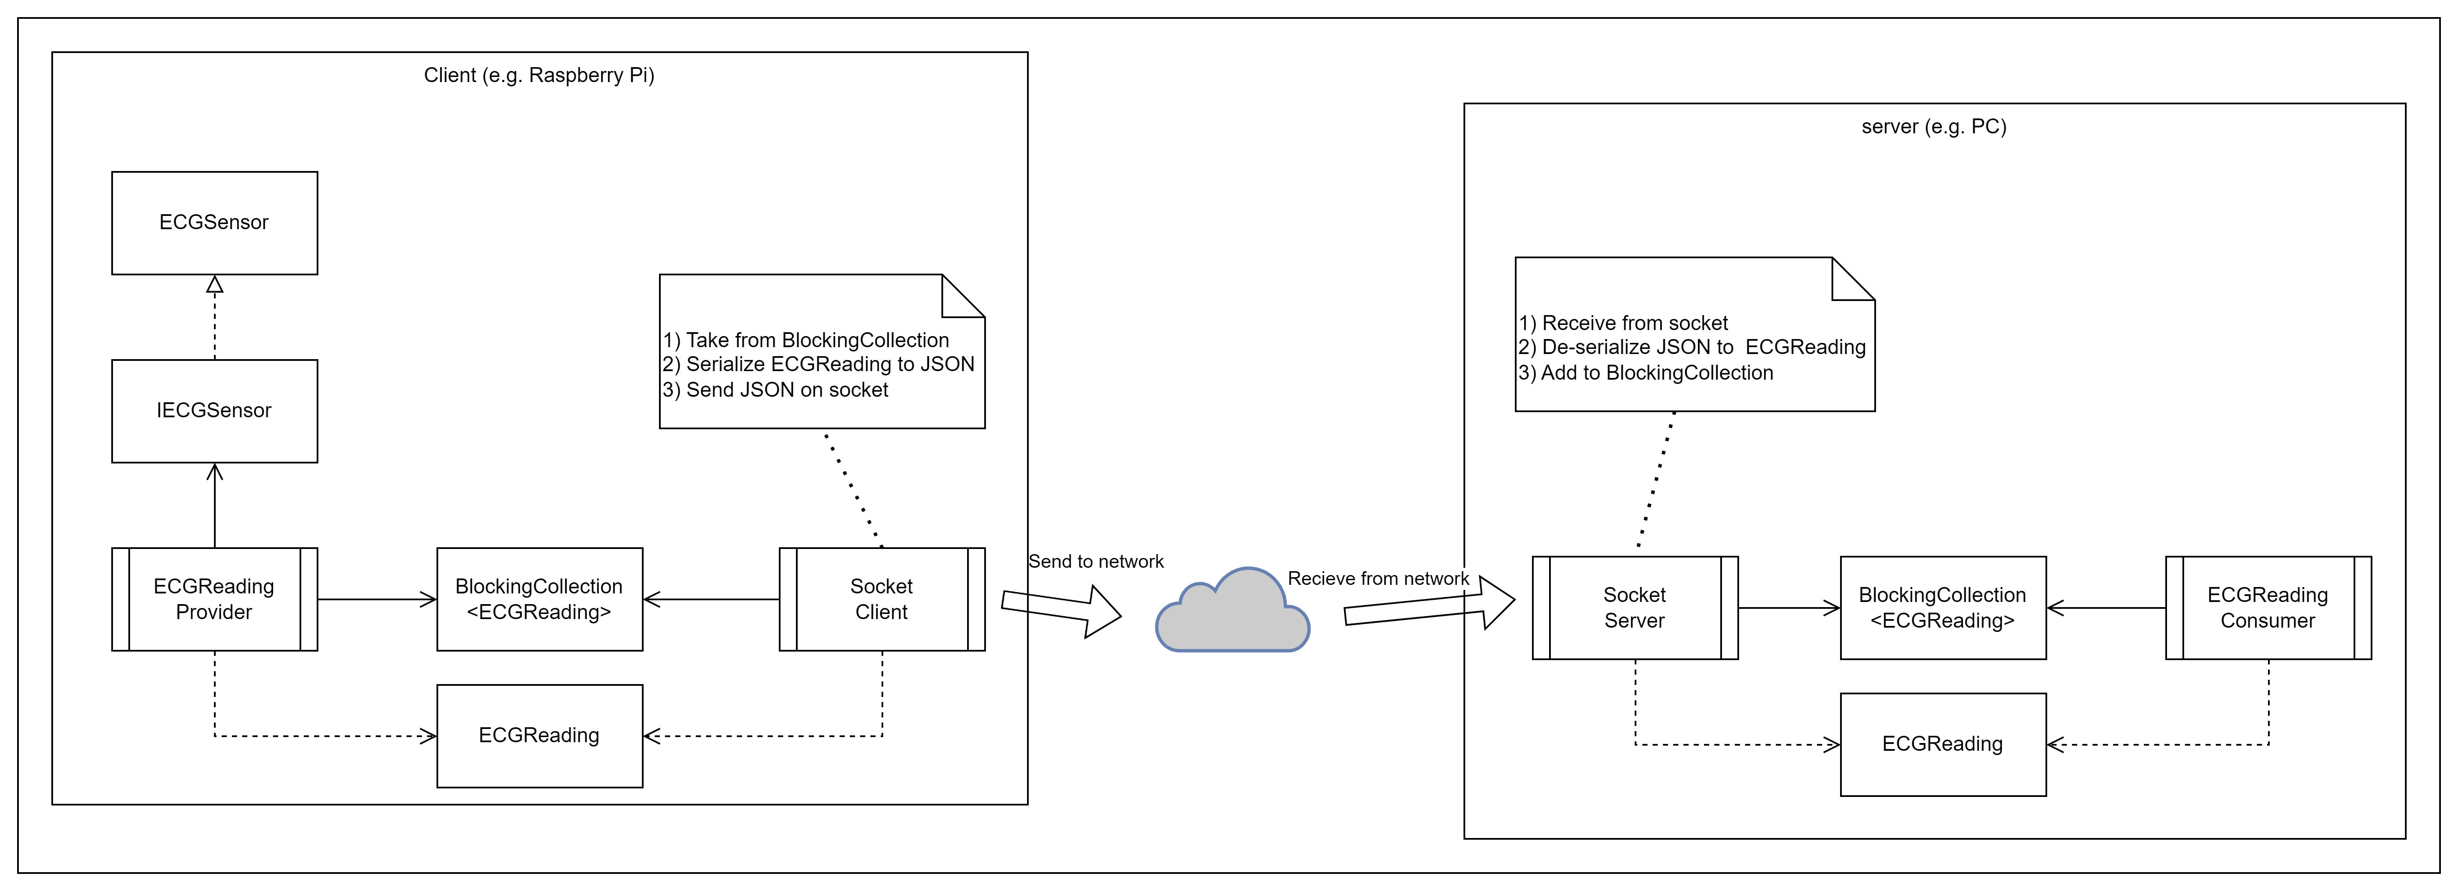
To this

Slide 6
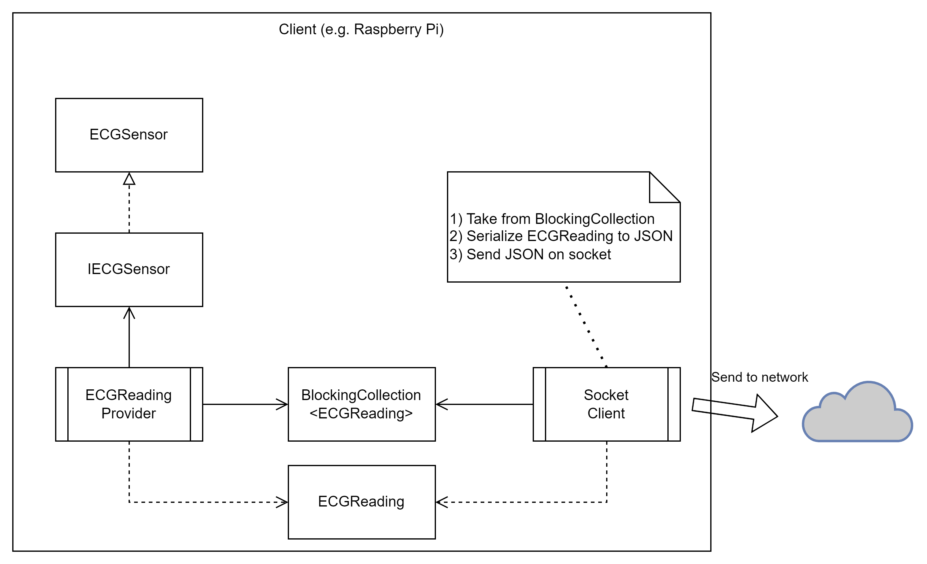
Client

Slide 7
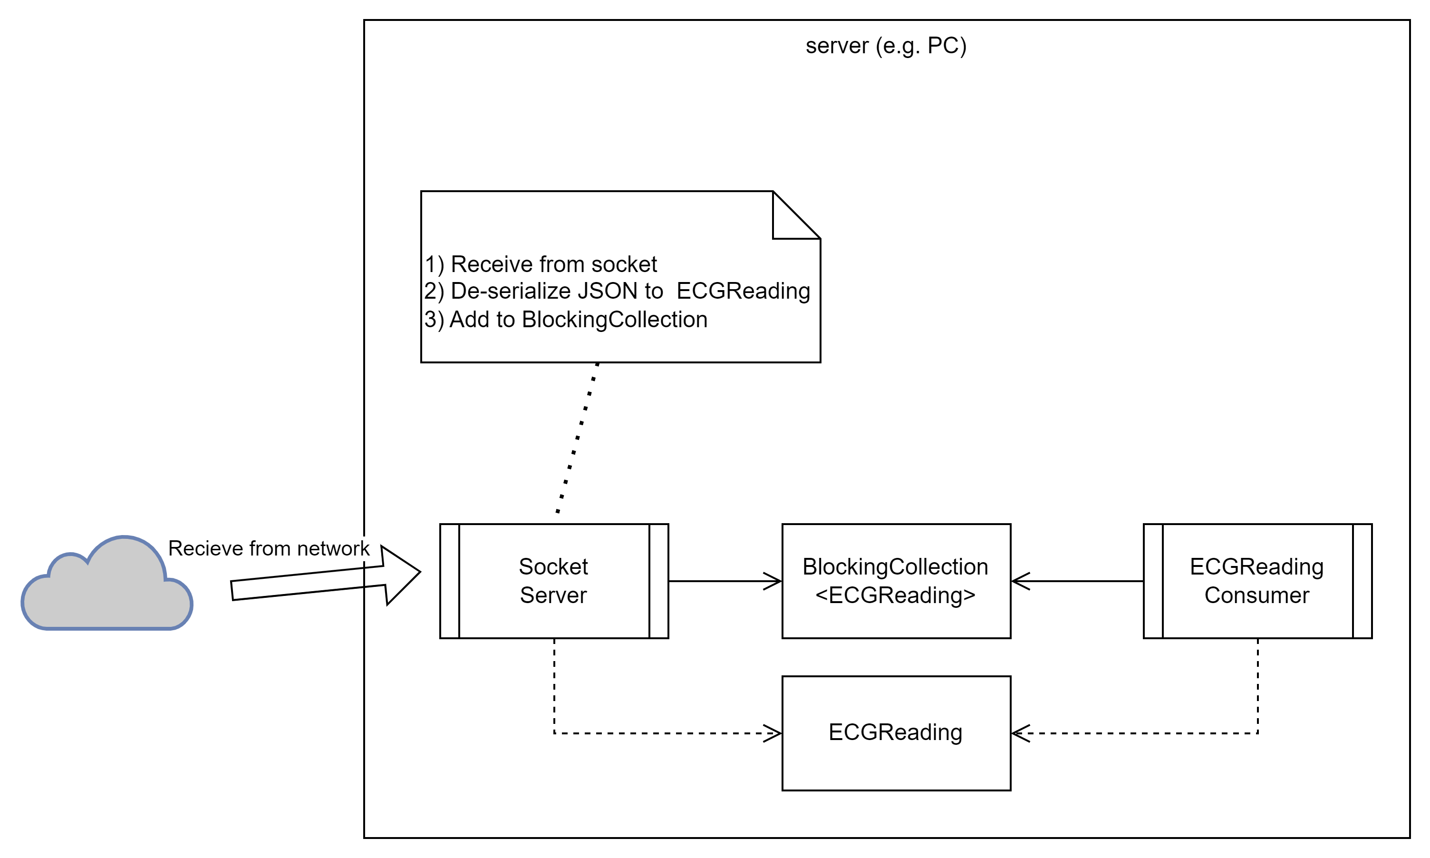
Server

Slide 8
Socket communication

Slide 9
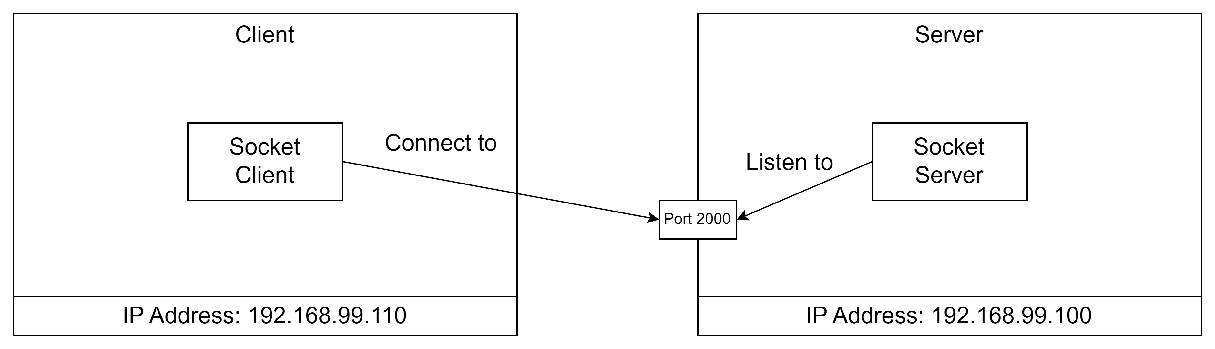
The server listens
The Server specifies where to listen:
IP Address
Port number

Slide 10
The server listens
The server can have multiple network cards and more than one address.
IP Address to listen to can be:
Any <= all network interfaces
Loopback <= 127.0.0.1
A specific IP address
The Server specifies where to listen:
IP Address
Port number

Slide 11
The client connects to the server
The client connects to a server socket:
IP Address
Port number

Slide 12
SocketServer
class SocketServer
{
public void RunServer()
{
// listen to 'Any' which means all network addresses for this machine
IPAddress ipAddress = IPAddress.Any;
IPEndPoint ipEndPoint = new IPEndPoint(ipAddress, 2000);
using Socket listener = new Socket(ipEndPoint.AddressFamily, SocketType.Stream, ProtocolType.Tcp);
listener.Bind(ipEndPoint);
Console.WriteLine($"Listening on: {ipAddress}");
listener.Listen();
var handler = listener.Accept();
while (true)
{
byte[] buffer = new byte[1024];
int numberOfBytesReceived = handler.Receive(buffer, SocketFlags.None);
string receivedData = Encoding.UTF8.GetString(buffer, 0, numberOfBytesReceived);
Console.WriteLine($"Server received:{receivedData}");
string reply = "ACK";
byte[] replyBytes = Encoding.UTF8.GetBytes(reply);
handler.Send(replyBytes, SocketFlags.None);
}
}
}

Slide 13
SocketServer
Create and IPEndPoint with Address = Any and Port = 2000.
class SocketServer
{
public void RunServer()
{
// listen to 'Any' which means all network addresses for this machine
IPAddress ipAddress = IPAddress.Any;
IPEndPoint ipEndPoint = new IPEndPoint(ipAddress, 2000);
using Socket listener = new Socket(ipEndPoint.AddressFamily, SocketType.Stream, ProtocolType.Tcp);
listener.Bind(ipEndPoint);
Console.WriteLine($"Listening on: {ipAddress}");
listener.Listen();
var handler = listener.Accept();
while (true)
{
byte[] buffer = new byte[1024];
int numberOfBytesReceived = handler.Receive(buffer, SocketFlags.None);
string receivedData = Encoding.UTF8.GetString(buffer, 0, numberOfBytesReceived);
Console.WriteLine($"Server received:{receivedData}");
string reply = "ACK";
byte[] replyBytes = Encoding.UTF8.GetBytes(reply);
handler.Send(replyBytes, SocketFlags.None);
}
}
}

Slide 14
SocketServer
Create a new socket.
‘AddressFamily’ is the one for IP addresses – ”InterNetwork”.
Socket type is Stream, which means a two-way data stream.
The protocol type is Transmission Control Protocol - TCP.
class SocketServer
{
public void RunServer()
{
// listen to 'Any' which means all network addresses for this machine
IPAddress ipAddress = IPAddress.Any;
IPEndPoint ipEndPoint = new IPEndPoint(ipAddress, 2000);
using Socket listener = new Socket(ipEndPoint.AddressFamily, SocketType.Stream, ProtocolType.Tcp);
listener.Bind(ipEndPoint);
Console.WriteLine($"Listening on: {ipAddress}");
listener.Listen();
var handler = listener.Accept();
while (true)
{
byte[] buffer = new byte[1024];
int numberOfBytesReceived = handler.Receive(buffer, SocketFlags.None);
string receivedData = Encoding.UTF8.GetString(buffer, 0, numberOfBytesReceived);
Console.WriteLine($"Server received:{receivedData}");
string reply = "ACK";
byte[] replyBytes = Encoding.UTF8.GetBytes(reply);
handler.Send(replyBytes, SocketFlags.None);
}
}
}

Slide 15
SocketServer
Create a new socket.
‘AddressFamily’ is the one for IP addresses – ”InterNetwork”.
Socket type is Stream, which means a two-way data stream.
The protocol type is Transmission Control Protocol - TCP.
class SocketServer
{
public void RunServer()
{
// listen to 'Any' which means all network addresses for this machine
IPAddress ipAddress = IPAddress.Any;
IPEndPoint ipEndPoint = new IPEndPoint(ipAddress, 2000);
using Socket listener = new Socket(ipEndPoint.AddressFamily, SocketType.Stream, ProtocolType.Tcp);
listener.Bind(ipEndPoint);
Console.WriteLine($"Listening on: {ipAddress}");
listener.Listen();
var handler = listener.Accept();
while (true)
{
byte[] buffer = new byte[1024];
int numberOfBytesReceived = handler.Receive(buffer, SocketFlags.None);
string receivedData = Encoding.UTF8.GetString(buffer, 0, numberOfBytesReceived);
Console.WriteLine($"Server received:{receivedData}");
string reply = "ACK";
byte[] replyBytes = Encoding.UTF8.GetBytes(reply);
handler.Send(replyBytes, SocketFlags.None);
}
}
}
The Socket implements the ‘IDisposable’ interface.
The ‘using’ keywork means, that the ‘listener’ object will be disposed correctly, even if any exceptions occur in the code.

Slide 16
SocketServer
Associate socket with local endpoint on the machine.
class SocketServer
{
public void RunServer()
{
// listen to 'Any' which means all network addresses for this machine
IPAddress ipAddress = IPAddress.Any;
IPEndPoint ipEndPoint = new IPEndPoint(ipAddress, 2000);
using Socket listener = new Socket(ipEndPoint.AddressFamily, SocketType.Stream, ProtocolType.Tcp);
listener.Bind(ipEndPoint);
Console.WriteLine($"Listening on: {ipAddress}");
listener.Listen();
var handler = listener.Accept();
while (true)
{
byte[] buffer = new byte[1024];
int numberOfBytesReceived = handler.Receive(buffer, SocketFlags.None);
string receivedData = Encoding.UTF8.GetString(buffer, 0, numberOfBytesReceived);
Console.WriteLine($"Server received:{receivedData}");
string reply = "ACK";
byte[] replyBytes = Encoding.UTF8.GetBytes(reply);
handler.Send(replyBytes, SocketFlags.None);
}
}
}

Slide 17
SocketServer
Start listening on the socket.
class SocketServer
{
public void RunServer()
{
// listen to 'Any' which means all network addresses for this machine
IPAddress ipAddress = IPAddress.Any;
IPEndPoint ipEndPoint = new IPEndPoint(ipAddress, 2000);
using Socket listener = new Socket(ipEndPoint.AddressFamily, SocketType.Stream, ProtocolType.Tcp);
listener.Bind(ipEndPoint);
Console.WriteLine($"Listening on: {ipAddress}");
listener.Listen();
var handler = listener.Accept();
while (true)
{
byte[] buffer = new byte[1024];
int numberOfBytesReceived = handler.Receive(buffer, SocketFlags.None);
string receivedData = Encoding.UTF8.GetString(buffer, 0, numberOfBytesReceived);
Console.WriteLine($"Server received:{receivedData}");
string reply = "ACK";
byte[] replyBytes = Encoding.UTF8.GetBytes(reply);
handler.Send(replyBytes, SocketFlags.None);
}
}
}

Slide 18
SocketServer
Wait for a connection from a client.
class SocketServer
{
public void RunServer()
{
// listen to 'Any' which means all network addresses for this machine
IPAddress ipAddress = IPAddress.Any;
IPEndPoint ipEndPoint = new IPEndPoint(ipAddress, 2000);
using Socket listener = new Socket(ipEndPoint.AddressFamily, SocketType.Stream, ProtocolType.Tcp);
listener.Bind(ipEndPoint);
Console.WriteLine($"Listening on: {ipAddress}");
listener.Listen();
var handler = listener.Accept();
while (true)
{
byte[] buffer = new byte[1024];
int numberOfBytesReceived = handler.Receive(buffer, SocketFlags.None);
string receivedData = Encoding.UTF8.GetString(buffer, 0, numberOfBytesReceived);
Console.WriteLine($"Server received:{receivedData}");
string reply = "ACK";
byte[] replyBytes = Encoding.UTF8.GetBytes(reply);
handler.Send(replyBytes, SocketFlags.None);
}
}
}

Slide 19
SocketServer
Read bytes from the socket in to a buffer
class SocketServer
{
public void RunServer()
{
// listen to 'Any' which means all network addresses for this machine
IPAddress ipAddress = IPAddress.Any;
IPEndPoint ipEndPoint = new IPEndPoint(ipAddress, 2000);
using Socket listener = new Socket(ipEndPoint.AddressFamily, SocketType.Stream, ProtocolType.Tcp);
listener.Bind(ipEndPoint);
Console.WriteLine($"Listening on: {ipAddress}");
listener.Listen();
var handler = listener.Accept();
while (true)
{
byte[] buffer = new byte[1024];
int numberOfBytesReceived = handler.Receive(buffer, SocketFlags.None);
string receivedData = Encoding.UTF8.GetString(buffer, 0, numberOfBytesReceived);
Console.WriteLine($"Server received:{receivedData}");
string reply = "ACK";
byte[] replyBytes = Encoding.UTF8.GetBytes(reply);
handler.Send(replyBytes, SocketFlags.None);
}
}
}

Slide 20
SocketServer
Convert to text (UTF-8)
class SocketServer
{
public void RunServer()
{
// listen to 'Any' which means all network addresses for this machine
IPAddress ipAddress = IPAddress.Any;
IPEndPoint ipEndPoint = new IPEndPoint(ipAddress, 2000);
using Socket listener = new Socket(ipEndPoint.AddressFamily, SocketType.Stream, ProtocolType.Tcp);
listener.Bind(ipEndPoint);
Console.WriteLine($"Listening on: {ipAddress}");
listener.Listen();
var handler = listener.Accept();
while (true)
{
byte[] buffer = new byte[1024];
int numberOfBytesReceived = handler.Receive(buffer, SocketFlags.None);
string receivedData = Encoding.UTF8.GetString(buffer, 0, numberOfBytesReceived);
Console.WriteLine($"Server received:{receivedData}");
string reply = "ACK";
byte[] replyBytes = Encoding.UTF8.GetBytes(reply);
handler.Send(replyBytes, SocketFlags.None);
}
}
}

Slide 21
SocketServer
Read bytes from the socket in to a buffer
class SocketServer
{
public void RunServer()
{
// listen to 'Any' which means all network addresses for this machine
IPAddress ipAddress = IPAddress.Any;
IPEndPoint ipEndPoint = new IPEndPoint(ipAddress, 2000);
using Socket listener = new Socket(ipEndPoint.AddressFamily, SocketType.Stream, ProtocolType.Tcp);
listener.Bind(ipEndPoint);
Console.WriteLine($"Listening on: {ipAddress}");
listener.Listen();
var handler = listener.Accept();
while (true)
{
byte[] buffer = new byte[1024];
int numberOfBytesReceived = handler.Receive(buffer, SocketFlags.None);
string receivedData = Encoding.UTF8.GetString(buffer, 0, numberOfBytesReceived);
Console.WriteLine($"Server received:{receivedData}");
string reply = "ACK";
byte[] replyBytes = Encoding.UTF8.GetBytes(reply);
handler.Send(replyBytes, SocketFlags.None);
}
}
}

Slide 22
SocketServer
Send ”ACK” message back to the client.
NOTE:
There is no requirement to send anything back to the client. It is only included here to show two-way communication.
class SocketServer
{
public void RunServer()
{
// listen to 'Any' which means all network addresses for this machine
IPAddress ipAddress = IPAddress.Any;
IPEndPoint ipEndPoint = new IPEndPoint(ipAddress, 2000);
using Socket listener = new Socket(ipEndPoint.AddressFamily, SocketType.Stream, ProtocolType.Tcp);
listener.Bind(ipEndPoint);
Console.WriteLine($"Listening on: {ipAddress}");
listener.Listen();
var handler = listener.Accept();
while (true)
{
byte[] buffer = new byte[1024];
int numberOfBytesReceived = handler.Receive(buffer, SocketFlags.None);
string receivedData = Encoding.UTF8.GetString(buffer, 0, numberOfBytesReceived);
Console.WriteLine($"Server received:{receivedData}");
string reply = "ACK";
byte[] replyBytes = Encoding.UTF8.GetBytes(reply);
handler.Send(replyBytes, SocketFlags.None);
}
}
}

Slide 23
The server listens
The Server specifies where to listen:
IP Address = Any
Port number = 2000

Slide 24
The client connects to the server
The client connects to a server socket:
IP Address
Port number
Notes:
Now let’s do the client.

Slide 25
SocketClient
class SocketClient
{
public void RunClient()
{
IPAddress ipAddress = IPAddress.Parse("127.0.0.1");
IPEndPoint ipEndPoint = new IPEndPoint(ipAddress, 2000);
using Socket client = new Socket(ipEndPoint.AddressFamily, SocketType.Stream, ProtocolType.Tcp);
client.Connect(ipEndPoint);
for (int i = 0; i < 10; i++)
{
// Send message.
var message = "Hello " + i;
var messageBytes = Encoding.UTF8.GetBytes(message);
client.Send(messageBytes, SocketFlags.None);
Console.WriteLine($"Socket client sent message: {message}");
// Receive ack.
var buffer = new byte[1024];
var received = client.Receive(buffer, SocketFlags.None);
var response = Encoding.UTF8.GetString(buffer, 0, received);
Console.WriteLine($"Client received: {response}");
Thread.Sleep(1000);
}
client.Shutdown(SocketShutdown.Both);
}

Slide 26
SocketClient
Create and IPEndPoint with
Address = 127.0.0.1 (localhost)
and
Port = 2000.
If the server is on a different machine, the Address shall be the IP address of that machine.
class SocketClient
{
public void RunClient()
{
IPAddress ipAddress = IPAddress.Parse("127.0.0.1");
IPEndPoint ipEndPoint = new IPEndPoint(ipAddress, 2000);
using Socket client = new Socket(ipEndPoint.AddressFamily, SocketType.Stream, ProtocolType.Tcp);
client.Connect(ipEndPoint);
for (int i = 0; i < 10; i++)
{
// Send message.
var message = "Hello " + i;
var messageBytes = Encoding.UTF8.GetBytes(message);
client.Send(messageBytes, SocketFlags.None);
Console.WriteLine($"Socket client sent message: {message}");
// Receive ack.
var buffer = new byte[1024];
var received = client.Receive(buffer, SocketFlags.None);
var response = Encoding.UTF8.GetString(buffer, 0, received);
Console.WriteLine($"Client received: {response}");
Thread.Sleep(1000);
}
client.Shutdown(SocketShutdown.Both);
}

Slide 27
SocketClient
Create the socket and connect to the IP Endpoint.
The connection attempt may time out if the endpoint does not exist, which will throw an exception.
class SocketClient
{
public void RunClient()
{
IPAddress ipAddress = IPAddress.Parse("127.0.0.1");
IPEndPoint ipEndPoint = new IPEndPoint(ipAddress, 2000);
using Socket client = new Socket(ipEndPoint.AddressFamily, SocketType.Stream, ProtocolType.Tcp);
client.Connect(ipEndPoint);
for (int i = 0; i < 10; i++)
{
// Send message.
var message = "Hello " + i;
var messageBytes = Encoding.UTF8.GetBytes(message);
client.Send(messageBytes, SocketFlags.None);
Console.WriteLine($"Socket client sent message: {message}");
// Receive ack.
var buffer = new byte[1024];
var received = client.Receive(buffer, SocketFlags.None);
var response = Encoding.UTF8.GetString(buffer, 0, received);
Console.WriteLine($"Client received: {response}");
Thread.Sleep(1000);
}
client.Shutdown(SocketShutdown.Both);
}

Slide 28
SocketClient
Create the message to send.
Convert to bytes.
Send the bytes.
class SocketClient
{
public void RunClient()
{
IPAddress ipAddress = IPAddress.Parse("127.0.0.1");
IPEndPoint ipEndPoint = new IPEndPoint(ipAddress, 2000);
using Socket client = new Socket(ipEndPoint.AddressFamily, SocketType.Stream, ProtocolType.Tcp);
client.Connect(ipEndPoint);
for (int i = 0; i < 10; i++)
{
// Send message.
var message = "Hello " + i;
var messageBytes = Encoding.UTF8.GetBytes(message);
client.Send(messageBytes, SocketFlags.None);
Console.WriteLine($"Socket client sent message: {message}");
// Receive ack.
var buffer = new byte[1024];
var received = client.Receive(buffer, SocketFlags.None);
var response = Encoding.UTF8.GetString(buffer, 0, received);
Console.WriteLine($"Client received: {response}");
Thread.Sleep(1000);
}
client.Shutdown(SocketShutdown.Both);
}

Slide 29
SocketClient
Receive ”ACK” message from the server.
NOTE:
There is no requirement to send anything back to the client. It is only included here to show two-way communication.
class SocketClient
{
public void RunClient()
{
IPAddress ipAddress = IPAddress.Parse("127.0.0.1");
IPEndPoint ipEndPoint = new IPEndPoint(ipAddress, 2000);
using Socket client = new Socket(ipEndPoint.AddressFamily, SocketType.Stream, ProtocolType.Tcp);
client.Connect(ipEndPoint);
for (int i = 0; i < 10; i++)
{
// Send message.
var message = "Hello " + i;
var messageBytes = Encoding.UTF8.GetBytes(message);
client.Send(messageBytes, SocketFlags.None);
Console.WriteLine($"Socket client sent message: {message}");
// Receive ack.
var buffer = new byte[1024];
var received = client.Receive(buffer, SocketFlags.None);
var response = Encoding.UTF8.GetString(buffer, 0, received);
Console.WriteLine($"Client received: {response}");
Thread.Sleep(1000);
}
client.Shutdown(SocketShutdown.Both);
}

Slide 30
SocketClient
Shutdown both sending and receiving socket when done.
class SocketClient
{
public void RunClient()
{
IPAddress ipAddress = IPAddress.Parse("127.0.0.1");
IPEndPoint ipEndPoint = new IPEndPoint(ipAddress, 2000);
using Socket client = new Socket(ipEndPoint.AddressFamily, SocketType.Stream, ProtocolType.Tcp);
client.Connect(ipEndPoint);
for (int i = 0; i < 10; i++)
{
// Send message.
var message = "Hello " + i;
var messageBytes = Encoding.UTF8.GetBytes(message);
client.Send(messageBytes, SocketFlags.None);
Console.WriteLine($"Socket client sent message: {message}");
// Receive ack.
var buffer = new byte[1024];
var received = client.Receive(buffer, SocketFlags.None);
var response = Encoding.UTF8.GetString(buffer, 0, received);
Console.WriteLine($"Client received: {response}");
Thread.Sleep(1000);
}
client.Shutdown(SocketShutdown.Both);
}

Slide 31

Your turn
Solve the
”Exercise - Client-Server communication”

Slide 32
Sending objects from the client
internal class SocketClient
{
private readonly BlockingCollection<ECGReading> _ecgReadings;
public SocketClient(BlockingCollection<ECGReading> ecgReadings)
{
_ecgReadings = ecgReadings;
}
public void Run()
{
IPAddress ipAddress = IPAddress.Parse("127.0.0.1");
IPEndPoint ipEndPoint = new IPEndPoint(ipAddress, 2000);
using Socket client = new Socket(ipEndPoint.AddressFamily, SocketType.Stream, ProtocolType.Tcp);
client.Connect(ipEndPoint);
while (!_ecgReadings.IsCompleted)
{
try
{
ECGReading ecgReading = _ecgReadings.Take();
string objectAsJson = JsonSerializer.Serialize(ecgReading);
var messageBytes = Encoding.UTF8.GetBytes(objectAsJson);
client.Send(messageBytes, SocketFlags.None);
Console.WriteLine($"Socket client sent message: {objectAsJson}");
}
catch (InvalidOperationException)
{
// IOE means that Take() was called on a completed collection.
}
}
client.Shutdown(SocketShutdown.Both);
}
}

Slide 33
Sending objects from the client
internal class SocketClient
{
private readonly BlockingCollection<ECGReading> _ecgReadings;
public SocketClient(BlockingCollection<ECGReading> ecgReadings)
{
_ecgReadings = ecgReadings;
}
public void Run()
{
IPAddress ipAddress = IPAddress.Parse("127.0.0.1");
IPEndPoint ipEndPoint = new IPEndPoint(ipAddress, 2000);
using Socket client = new Socket(ipEndPoint.AddressFamily, SocketType.Stream, ProtocolType.Tcp);
client.Connect(ipEndPoint);
while (!_ecgReadings.IsCompleted)
{
try
{
ECGReading ecgReading = _ecgReadings.Take();
string objectAsJson = JsonSerializer.Serialize(ecgReading);
var messageBytes = Encoding.UTF8.GetBytes(objectAsJson);
client.Send(messageBytes, SocketFlags.None);
Console.WriteLine($"Socket client sent message: {objectAsJson}");
}
catch (InvalidOperationException)
{
// IOE means that Take() was called on a completed collection.
}
}
client.Shutdown(SocketShutdown.Both);
}
}

Slide 34
Sending objects from the client
internal class SocketClient
{
private readonly BlockingCollection<ECGReading> _ecgReadings;
public SocketClient(BlockingCollection<ECGReading> ecgReadings)
{
_ecgReadings = ecgReadings;
}
public void Run()
{
IPAddress ipAddress = IPAddress.Parse("127.0.0.1");
IPEndPoint ipEndPoint = new IPEndPoint(ipAddress, 2000);
using Socket client = new Socket(ipEndPoint.AddressFamily, SocketType.Stream, ProtocolType.Tcp);
client.Connect(ipEndPoint);
while (!_ecgReadings.IsCompleted)
{
try
{
ECGReading ecgReading = _ecgReadings.Take();
string objectAsJson = JsonSerializer.Serialize(ecgReading);
var messageBytes = Encoding.UTF8.GetBytes(objectAsJson);
client.Send(messageBytes, SocketFlags.None);
Console.WriteLine($"Socket client sent message: {objectAsJson}");
}
catch (InvalidOperationException)
{
// IOE means that Take() was called on a completed collection.
}
}
client.Shutdown(SocketShutdown.Both);
}
}

Slide 35
Receiving objects on the server
internal class SocketServer
{
private readonly BlockingCollection<ECGReading> _ecgReadings;
public SocketServer(BlockingCollection<ECGReading> ecgReadings)
{
_ecgReadings = ecgReadings;
}
public void Run()
{
RunServer();
}
public void RunServer()
{
// listen to 'Any' which means all network addresses for this machine
IPAddress ipAddress = IPAddress.Any;
IPEndPoint ipEndPoint = new IPEndPoint(ipAddress, 2000);
using Socket listener = new Socket(ipEndPoint.AddressFamily, SocketType.Stream, ProtocolType.Tcp);
listener.Bind(ipEndPoint);
Console.WriteLine($"Listening on: {ipAddress}");
listener.Listen();
var handler = listener.Accept();
while (!ShallStop)
{
byte[] buffer = new byte[1024];
int numberOfBytesReceived = handler.Receive(buffer, SocketFlags.None);
if (numberOfBytesReceived > 0)
{
string receivedData = Encoding.UTF8.GetString(buffer, 0, numberOfBytesReceived);
Console.WriteLine($"Server received:{receivedData}");
try
{
ECGReading? ecgReading = JsonSerializer.Deserialize<ECGReading>(receivedData);
if (ecgReading != null) _ecgReadings.Add(ecgReading);
}
catch (System.Text.Json.JsonException e)
{
// log any parsing exceptions
Console.WriteLine(e);
}
}
}
listener.Close();
_ecgReadings.CompleteAdding();
}
public bool ShallStop { get; set; } = false;
}

Slide 36
Receiving objects on the server
internal class SocketServer
{
private readonly BlockingCollection<ECGReading> _ecgReadings;
public SocketServer(BlockingCollection<ECGReading> ecgReadings)
{
_ecgReadings = ecgReadings;
}
public void Run()
{
RunServer();
}
public void RunServer()
{
// listen to 'Any' which means all network addresses for this machine
IPAddress ipAddress = IPAddress.Any;
IPEndPoint ipEndPoint = new IPEndPoint(ipAddress, 2000);
using Socket listener = new Socket(ipEndPoint.AddressFamily, SocketType.Stream, ProtocolType.Tcp);
listener.Bind(ipEndPoint);
Console.WriteLine($"Listening on: {ipAddress}");
listener.Listen();
var handler = listener.Accept();
while (!ShallStop)
{
byte[] buffer = new byte[1024];
int numberOfBytesReceived = handler.Receive(buffer, SocketFlags.None);
if (numberOfBytesReceived > 0)
{
string receivedData = Encoding.UTF8.GetString(buffer, 0, numberOfBytesReceived);
Console.WriteLine($"Server received:{receivedData}");
try
{
ECGReading? ecgReading = JsonSerializer.Deserialize<ECGReading>(receivedData);
if (ecgReading != null) _ecgReadings.Add(ecgReading);
}
catch (System.Text.Json.JsonException e)
{
// log any parsing exceptions
Console.WriteLine(e);
}
}
}
listener.Close();
_ecgReadings.CompleteAdding();
}
public bool ShallStop { get; set; } = false;
}

Slide 37
Receiving objects on the server
internal class SocketServer
{
private readonly BlockingCollection<ECGReading> _ecgReadings;
public SocketServer(BlockingCollection<ECGReading> ecgReadings)
{
_ecgReadings = ecgReadings;
}
public void Run()
{
RunServer();
}
public void RunServer()
{
// listen to 'Any' which means all network addresses for this machine
IPAddress ipAddress = IPAddress.Any;
IPEndPoint ipEndPoint = new IPEndPoint(ipAddress, 2000);
using Socket listener = new Socket(ipEndPoint.AddressFamily, SocketType.Stream, ProtocolType.Tcp);
listener.Bind(ipEndPoint);
Console.WriteLine($"Listening on: {ipAddress}");
listener.Listen();
var handler = listener.Accept();
while (!ShallStop)
{
byte[] buffer = new byte[1024];
int numberOfBytesReceived = handler.Receive(buffer, SocketFlags.None);
if (numberOfBytesReceived > 0)
{
string receivedData = Encoding.UTF8.GetString(buffer, 0, numberOfBytesReceived);
Console.WriteLine($"Server received:{receivedData}");
try
{
ECGReading? ecgReading = JsonSerializer.Deserialize<ECGReading>(receivedData);
if (ecgReading != null) _ecgReadings.Add(ecgReading);
}
catch (System.Text.Json.JsonException e)
{
// log any parsing exceptions
Console.WriteLine(e);
}
}
}
listener.Close();
_ecgReadings.CompleteAdding();
}
public bool ShallStop { get; set; } = false;
}

Slide 38
Receiving objects on the server
internal class SocketServer
{
private readonly BlockingCollection<ECGReading> _ecgReadings;
public SocketServer(BlockingCollection<ECGReading> ecgReadings)
{
_ecgReadings = ecgReadings;
}
public void Run()
{
RunServer();
}
public void RunServer()
{
// listen to 'Any' which means all network addresses for this machine
IPAddress ipAddress = IPAddress.Any;
IPEndPoint ipEndPoint = new IPEndPoint(ipAddress, 2000);
using Socket listener = new Socket(ipEndPoint.AddressFamily, SocketType.Stream, ProtocolType.Tcp);
listener.Bind(ipEndPoint);
Console.WriteLine($"Listening on: {ipAddress}");
listener.Listen();
var handler = listener.Accept();
while (!ShallStop)
{
byte[] buffer = new byte[1024];
int numberOfBytesReceived = handler.Receive(buffer, SocketFlags.None);
if (numberOfBytesReceived > 0)
{
string receivedData = Encoding.UTF8.GetString(buffer, 0, numberOfBytesReceived);
Console.WriteLine($"Server received:{receivedData}");
try
{
ECGReading? ecgReading = JsonSerializer.Deserialize<ECGReading>(receivedData);
if (ecgReading != null) _ecgReadings.Add(ecgReading);
}
catch (System.Text.Json.JsonException e)
{
// log any parsing exceptions
Console.WriteLine(e);
}
}
}
listener.Close();
_ecgReadings.CompleteAdding();
}
public bool ShallStop { get; set; } = false;
}

Slide 39
Your turn
Solve the
” Exercise - ECG Network”

Slide 40
References and image sources

